Slide 1
Medical Insurance Cost Prediction

Slide 2
INTRODUCTION
medical insurance cost prediction is a powerful application of data science and machine learning, aiming to estimate healthcare expenses based on individual characteristics. insurance companies use such predictive models to assess risk and determine premium costs, while individuals can gain insights into factors affecting their expenses.
Healthcare expenses can vary significantly based on a person's lifestyle, demographics, and medical history. By analyzing these factors, a machine learning model can provide more accurate cost estimates, helping insurers and policyholders make informed decisions.

Slide 3
Steps to achieve streamlit app with model
Data Preprocessing
Exploratory Data Analysis (EDA)
Medical Insurance Cost Prediction
Integrate with Mlflow
Streamlit App Development

Slide 4
Data Preprocessing
The first step in preparing data for the Medical Insurance Cost Prediction model is to load the dataset into a suitable environment. Using Python, libraries such as pandas and numpy are utilized to read and manipulate data efficiently
Before analysis, the dataset needs to be checked for missing values, inconsistent entries, and duplicate records. If missing data is found, appropriate strategies like imputation or row removal are applied to ensure a clean dataset.
Since machine learning models typically require numerical inputs, categorical features such as gender, smoker status, and region must be converted into numeric representations. Encoding techniques like One-Hot Encoding or Label Encoding are used for this transformation.

Slide 5
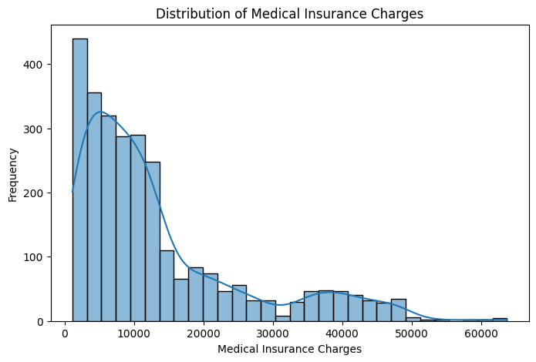
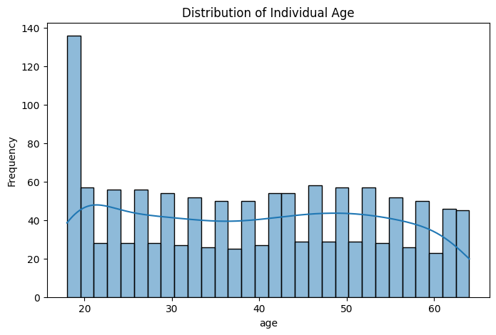
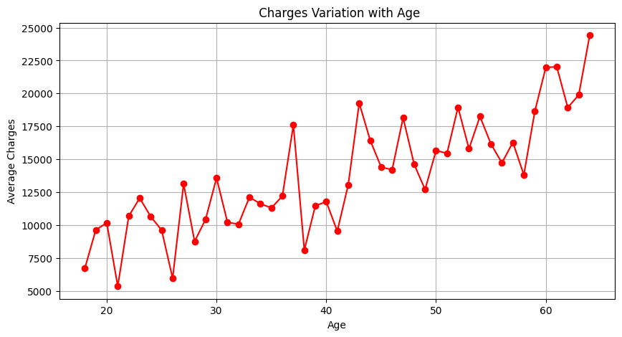
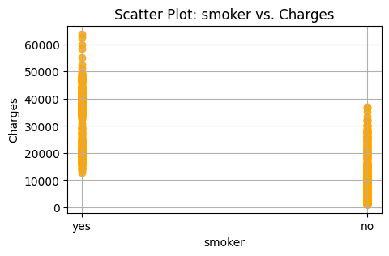
Exploratory Data Analysis (EDA)

Slide 6
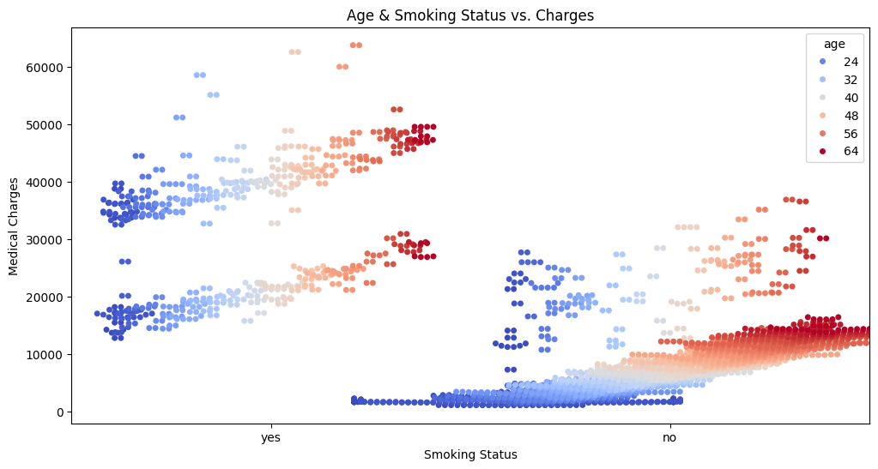
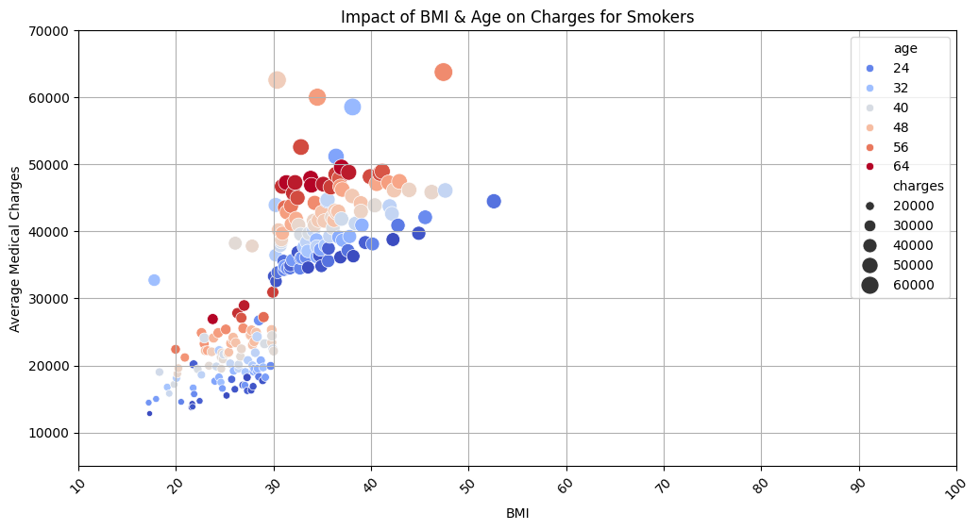
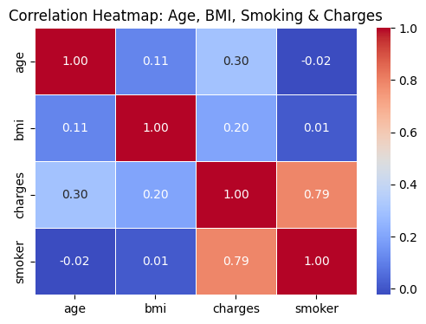
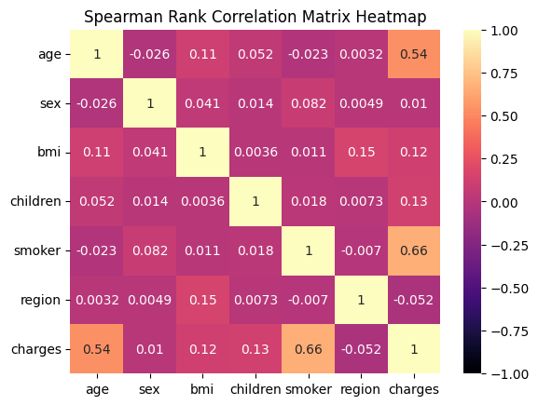

Slide 7
Medical Insurance Cost Prediction models
In this project, five to six different machine learning models were trained and evaluated to predict medical insurance costs. The performance of each model was assessed using key metrics such as R² Score, Mean Absolute Error (MAE), Mean Squared Error (MSE), and Root Mean Squared Error (RMSE).
Linear Regression
Random Forest Regressor
DecisionTreeRegressor
Support Vector Regression (SVR
XGBoost Regressor
Lightgbm

Slide 8
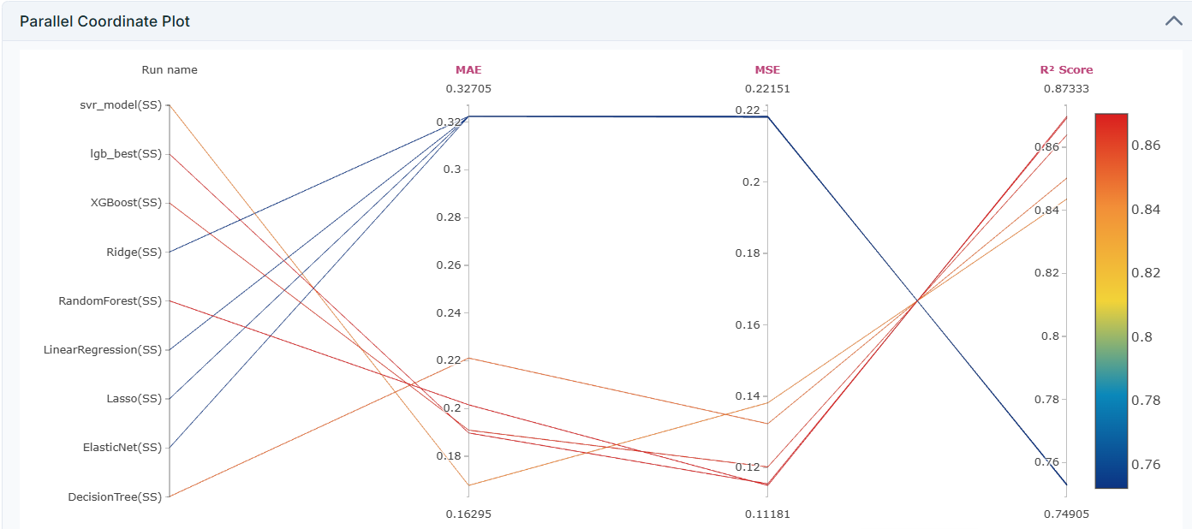
Integrate with Mlflow
Integrating MLflow with DagsHub enables efficient model tracking, version control, and reproducibility in machine learning workflows. By storing experiment results in a DagsHub repository, and select the best-performing model

Slide 9
Final Model Selection - Random Forest Regressor
After comparing the performance of multiple models, Random Forest Regressor was chosen as the best model for predicting medical insurance costs. This decision was based on its strong balance between accuracy, interpretability, and generalization capability.
The Random Forest Regressor was chosen as the best model for medical insurance cost prediction due to its remarkable accuracy and robust predictive capabilities. With a strong R² score, it ensures highly reliable forecasts, making it a valuable tool for analyzing insurance expenses.
Additionally, its ensemble learning approach, which combines multiple decision trees, helps minimize the risk of overfitting, making the model more adaptable to unseen data

Slide 10
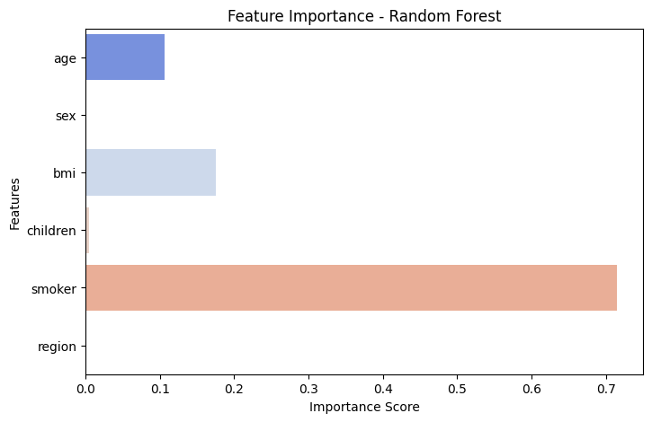
Feature Importance - Random Forest

Slide 11
Streamlit App Development
Exploratory Data Analysis part visualized
Exploratory Data Analysis was conducted to understand the dataset's structure and relationships between features.
Final Model Selection – Random Forest Regressor
After comparing multiple models, Random Forest Regressor was chosen as the best predictive model. The performance metrics R² Score, Mean Squared Error (MSE),Root Mean Squared Error (RMSE) visualized
Customer Insurance cost prediction done
The trained Random Forest model was integrated into a Streamlit-based web application, allowing users to enter their details and receive real-time insurance cost predictions.

